Slide 1
Clustering Algorithms and Dimensionality Reduction
Atul Kahate
https://www.linkedin.com/in/atulkahate/

Slide 2
Density-Based Clustering and DBSCAN
Groups points that are closely packed together and treats sparse points as noise (outliers)
  Clusters = High-density regions
  Noise = Low-density regions
DBSCAN (Density-Based Spatial Clustering of Applications with Noise)
  Most popular density-based clustering algorithm
Simple Intuition
  Think of people standing on a field
    Crowded groups → clusters
    Isolated people → noise
  DBSCAN finds the crowds, ignores loners
Use: Spatial data (GPS, maps), Anomaly detection, Image segmentation, When cluster shapes are irregular

Slide 3
DBSCAN Working
Key parameters
  ε (epsilon): Radius of neighborhood around a point
  MinPts: Minimum number of points required inside ε to form a dense region
Types of points
  Core point: Has ≥ MinPts points within ε
  Border point: Has < MinPts points, but lies within ε of a core point
  Noise (outlier): Not within ε of any core point
Working
  Pick an unvisited point
  Check its ε-neighborhood
  If points ≥ MinPts → mark as core point
  Form a cluster and expand it by visiting neighbors
  If points < MinPts → mark as noise
  Repeat until all points are processed
Example (2D points)
  ε = 1.0
  MinPts = 5
  If a point has 5 or more neighbors within radius 1.0, it starts a cluster

Slide 4
DBSCAN
Step 1: Choose DBSCAN parameters
ε (epsilon) → how close dogs must be in weight, say 2 kg
MinPts → minimum dogs needed to form a group, say 3 dogs
Meaning: At least 3 dogs within ±2 kg → dense region → cluster
Step 3: Border points
None in our dataset
But what if had a dog with weight 18 kg?
Not enough neighbors to be core
But close to light-dog cluster
Border point
Included in Cluster 1
Dog | Weight (kg) | Obese (y)
D1 | 9 | No
D2 | 10 | No
D3 | 11 | No
D4 | 12 | No
D5 | 13 | No
D6 | 26 | Yes
D7 | 27 | Yes
D8 | 28 | Yes
D9 | 29 | Yes
D10 | 30 | Yes
D11 | 45 | Yes
Step 4: Noise/Outliers
Dog with weight 45 kg
But what if had a dog with weight 18 kg?
No nearby dogs
DBSCAN labels it as an outlier
** DBSCAN is great for anomaly detection **
Step 2: Look at local neighbourhoods
Now DBSCAN will scan each dog
Light dogs 9, 10, 11, 12, 13
Each dog has many neighbors within 2 kg
Core points
DBSCAN forms Cluster 1 (light dogs)
Heavy dogs 26, 27, 28, 29, 30
Each dog has many neighbors within 2 kg
Core points
DBSCAN forms Cluster 2 (heavy dogs)
Step 5: Final clusters
Cluster 1: Light-weight dogs
Cluster 2: Heavy-weight dogs
Noise: Extremely unusual weights
Step 0: Understanding data
Each dog is a data point
We use X-axis: Weight (kg)
Hint: Imagine points placed on a number line based on weight
Summary: DBSCAN groups dogs with similar weights based on density, automatically finds light and heavy groups, and flags unusually weighted dogs as outliers—without using the obesity label
Step 6: Interpret clusters
Cluster | Observation
Light-weight cluster | Mostly Obese = No
Heavy-weight cluster | Mostly Obese = Yes
Noise | Abnormal cases
DBSCAN discovers structure first, labels later

Slide 5
Clustering Mixed Data
Basic idea: Almost all clustering algorithms are based on one idea: Similar points should be “close” to each other
Result: They need a way to answer: “How far apart are two data points?”
The “how far” is distance
Numeric data, no problem
  Height A = 170 cm, Height B = 175 cm, Distance = |170 − 175| = 5
Categorical/Non-numeric data, problem
  City A = Mumbai, City B = Delhi, Distance = ?
  What if we encode Mumbai = 1, Delhi = 2, Chennai = 3?
    Result: Chennai is “twice as far” from Mumbai as Delhi => Meaningless!
    Solution
      Same category: Distance = 0, Different category: Distance = 1
      Example: Mumbai -> Mumbai distance = 0, Mumbai -> Delhi distance = 1, Mumbai -> Chennai distance = 1

Slide 6

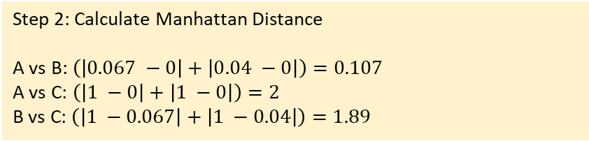
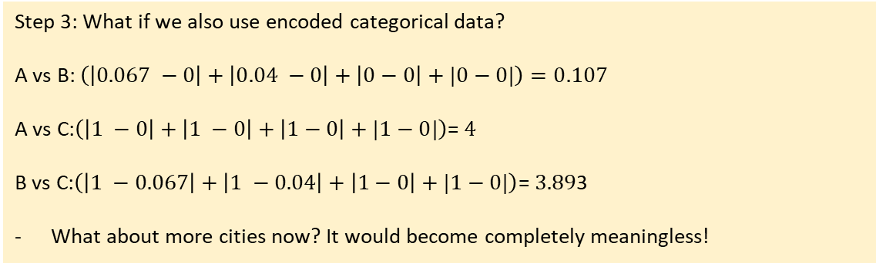
Manhattan Distance (L1) - Taxicab path
Distance between two points in a grid-based system (like streets in a city laid out in a grid)
Represents how a taxi would drive along streets (only horizontal and vertical moves) rather than "as the crow flies."
Step 2: Calculate Manhattan Distance
A vs B: $\left(\left|0.067 −0\right|+\left|0.04 −0\right|\right)=0.107$
A vs C: $\left(\left|1 −0\right|+\left|1 −0\right|\right)=2$
B vs C: $\left(\left|1 −0.067\right|+\left|1 −0.04\right|\right)=1.89$
Person | Age | Income (₹k) | Gender | City
A | 25 | 30 | M | Pune
B | 27 | 32 | M | Pune
C | 55 | 80 | F | Mumbai
Interpretation
Pair | Distance
A–B | 0.107 (very close)
A–C | 2 (far)
B–C | 1.89 (far)
Step 1: Find ranges for numeric types
Age: Min: 25, Max: 55, Range: 30
Inc: Min: 30, Max: 80, Range: 50
Step 3: What if we also use encoded categorical data?
A vs B: $\left(\left|0.067 −0\right|+\left|0.04 −0\right|+\left|0−0\right|+|0−0|\right)=0.107$
A vs C:$\left(\left|1 −0\right|+\left|1 −0\right|+\left|1−0\right|+|1−0|\right)$= $4$
B vs C:$\left(\left|1 −0.067\right|+\left|1 −0.04\right|+\left|1−0\right|+|1−0|\right)$= $3.89$3
What about more cities now? It would become completely meaningless!
Normalized and Scaled data
Person | Age | Income | Gender | City
A | 0 | 0 | 0 | 0
B | 0.067 | 0.04 | 0 | 0
C | 1 | 1 | 1 | 1
Conclusion: Fails for categorical data

Slide 7
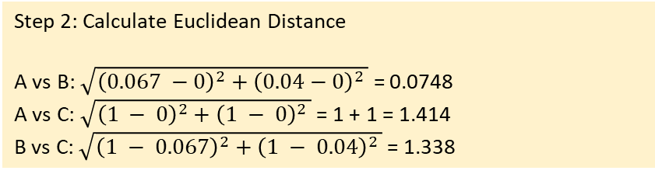
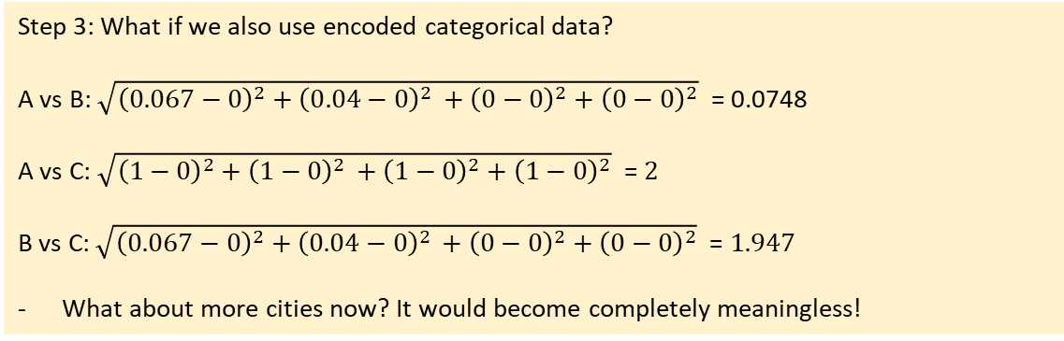
Euclidean Distance (L2) – Shortest Path
“As the crow flies”
Straight line distance between two points
Works only for numeric data of similar scales
Step 2: Calculate Euclidean Distance
A vs B: $\sqrt{{\left(0.067 −0\right)}^{2}+{\left(0.04−0\right)}^{2 }}$ = 0.0748
A vs C: $\sqrt{{\left(1 − 0\right)}^{2}+{\left(1 − 0\right)}^{2 }}$ = 1 + 1 = 1.414
B vs C: $\sqrt{{\left(1 − 0.067\right)}^{2}+{\left(1 − 0.04\right)}^{2 }}$ = 1.338
Person | Age | Income (₹k) | Gender | City
A | 25 | 30 | M | Pune
B | 27 | 32 | M | Pune
C | 55 | 80 | F | Mumbai
Interpretation
Pair | Distance
A–B | 0.0748 (very close)
A–C | 1.414 (far)
B–C | 1.338 (far)
Step 1: Find ranges for numeric types
Age: Min: 25, Max: 55, Range: 30
Inc: Min: 30, Max: 80, Range: 50
Step 3: What if we also use encoded categorical data?
A vs B: $\sqrt{{\left(0.067−0\right)}^{2}+{\left(0.04−0\right)}^{2 }+{\left(0−0\right)}^{2}+{\left(0−0\right)}^{2}}$ = 0.0748
A vs C: $\sqrt{{\left(1−0\right)}^{2}+{\left(1−0\right)}^{2 }+{\left(1−0\right)}^{2}+{\left(1−0\right)}^{2}}$ = $2$
B vs C: $\sqrt{{\left(0.067−0\right)}^{2}+{\left(0.04−0\right)}^{2 }+{\left(0−0\right)}^{2}+{\left(0−0\right)}^{2}}$ = $1.947$
What about more cities now? It would become completely meaningless!
Normalized and Scaled data
Person | Age | Income | Gender | City
A | 0 | 0 | 0 | 0
B | 0.067 | 0.04 | 0 | 0
C | 1 | 1 | 1 | 1
Conclusion: Fails for categorical data

Slide 8

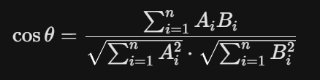
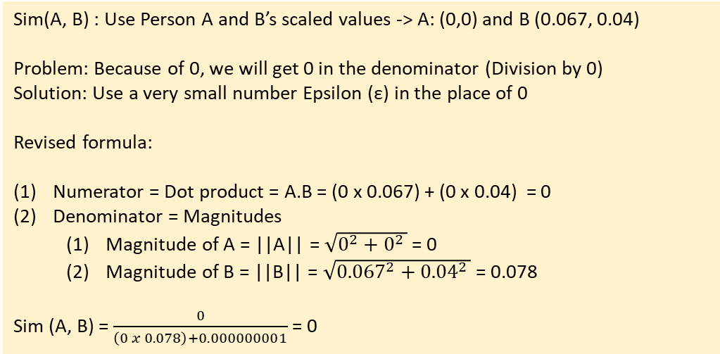
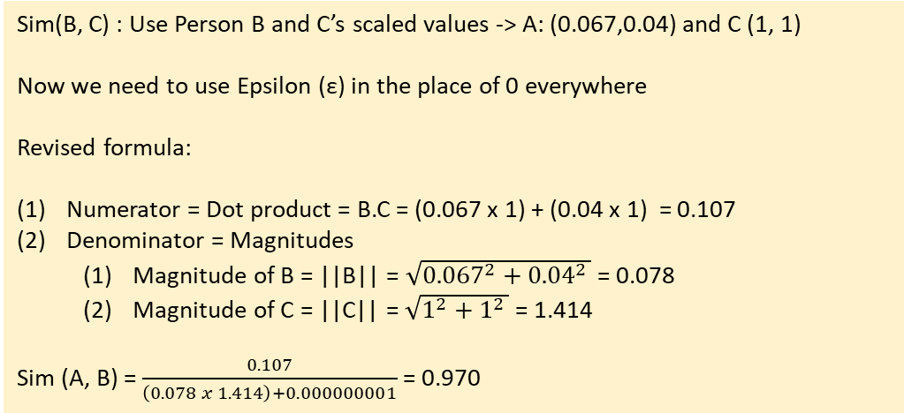
Cosine Similarity – Angle Difference
Measures the angle (cosine) between two values
Widely used for text similarity search
Sim(A, B) : Use Person A and B’s scaled values -> A: (0,0) and B (0.067, 0.04)
Problem: Because of 0, we will get 0 in the denominator (Division by 0)
Solution: Use a very small number Epsilon (ε) in the place of 0
Revised formula:
Numerator = Dot product = A.B = (0 x 0.067) + (0 x 0.04) = 0
Denominator = Magnitudes
  Magnitude of A = ||A|| = $\sqrt{0^{2}+0^{2 }}$ = 0
  Magnitude of B = ||B|| = $\sqrt{{0.067}^{2}+{0.04}^{2 }}$ = 0.078
Sim (A, B) = $\frac{0}{\left(0 x 0.078\right)+0.000000001}$ = 0
Person | Age | Income (₹k) | Gender | City
A | 25 | 30 | M | Pune
B | 27 | 32 | M | Pune
C | 55 | 80 | F | Mumbai
Cosine Similarity formula
Meaning: Dot product divided by product of magnitudes
Sim(B, C) : Use Person B and C’s scaled values -> A: (0.067,0.04) and C (1, 1)
Now we need to use Epsilon (ε) in the place of 0 everywhere
Revised formula:
Numerator = Dot product = B.C = (0.067 x 1) + (0.04 x 1) = 0.107
Denominator = Magnitudes
  Magnitude of B = ||B|| = $\sqrt{{0.067}^{2}+{0.04}^{2 }}$ = 0.078
  Magnitude of C = ||C|| = $\sqrt{1^{2}+1^{2 }}$ = 1.414
Sim (A, B) = $\frac{0.107}{\left(0.078 x 1.414\right)+0.000000001}$ = 0.970
Interpretation
Pair | Cosine Similarity
A–B | 0 (very different)
B–C | 0.970 (very similar)
But this is WRONG!
Happens because scaling made A = 0
Conclusion: Do not use Cosine Similarity here

Slide 9
Comparison
Feature | Manhattan (L1) | Euclidean (L2) | Cosine Similarity
Geometry | Grid-based (Taxicab) | Straight-line (Crow flies) | Angular difference
Sensitivity | Robust to outliers | Sensitive to outliers | Magnitude independent
Calculation | Sum of absolute diffs | Square root of Sum of squares | Dot product / Magnitudes
Best Used For | High-dimensional data | Physical/dense distance | Text embeddings / RAG
Intuition | Moving along axes | Direct physical gap | Shared "theme" or ratio
Example comparison | Data Reality | Distance (L1/L2) Says... | Cosine Says...
A vs B | Very Similar | Correct: "These are close" | Fails: "No direction (0)"
B vs C | Very Different | Correct: "These are far" | Misleading: "Same pattern (0.97)"

Slide 10
Gower Distance
Works by calculating a "partial score" (s) for each feature and then averaging them:
  Numeric data (Age, Income): Variation of Min-Max scaling is used to find the difference
  Categorical data (Gender, City): Uses a simple Boolean check
    Similar values -> Distance = 0 (e.g. Pune-Pune)
    Different values -> Distance = 1 (e.g. Pune-Mumbai)
  Result: Combines these into a single score between 0 and 1, where 0 is identical and 1 is completely different
Best for mixed data

Slide 11

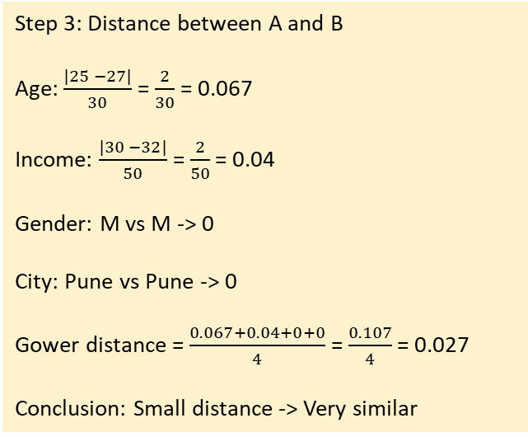
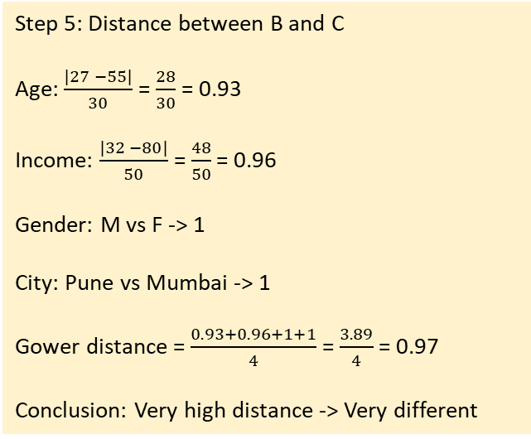
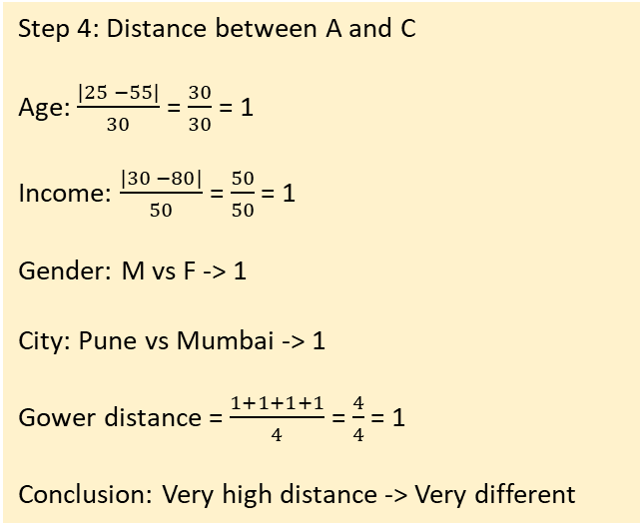
Gower Distance
Step 3: Distance between A and B
Age: $\frac{|25 −27|}{30}$ = $\frac{2}{30}$ = 0.067
Income: $\frac{|30 −32|}{50}$ = $\frac{2}{50}$ = 0.04
Gender: M vs M -> 0
City: Pune vs Pune -> 0
Gower distance = $\frac{0.067+0.04+0+0}{4}$ = $\frac{0.107}{4}$ = 0.027
Conclusion: Small distance -> Very similar
Step 5: Distance between B and C
Age: $\frac{|27 −55|}{30}$ = $\frac{28}{30}$ = 0.93
Income: $\frac{|32 −80|}{50}$ = $\frac{48}{50}$ = 0.96
Gender: M vs F -> 1
City: Pune vs Mumbai -> 1
Gower distance = $\frac{0.93+0.96+1+1}{4}$ = $\frac{3.89}{4}$ = 0.97
Conclusion: Very high distance -> Very different
Handles numeric, categorical, binary data
Scales everything to [0,1]
Combines distances feature-wise
Person | Age | Income (₹k) | Gender | City
A | 25 | 30 | M | Pune
B | 27 | 32 | M | Pune
C | 55 | 80 | F | Mumbai
Step 1: Identify feature types
Feature | Type | How distance is computed
Age | Numeric | normalized absolute difference
Income | Numeric | normalized absolute difference
Gender | Categorical | 0 if same, 1 if different
City | Categorical | 0 if same, 1 if different
Step 4: Distance between A and C
Age: $\frac{|25 −55|}{30}$ = $\frac{30}{30}$ = 1
Income: $\frac{|30 −80|}{50}$ = $\frac{50}{50}$ = 1
Gender: M vs F -> 1
City: Pune vs Mumbai -> 1
Gower distance = $\frac{1+1+1+1}{4}$ = $\frac{4}{4}$ = 1
Conclusion: Very high distance -> Very different
Final Gower matrix
 | A | B | C
A | 0.00 | 0.027 | 1.00
B | 0.027 | 0.00 | 0.97
C | 1.00 | 0.97 | 0.00
Step 2: Find ranges for numeric types
Age: Min: 25, Max: 55, Range: 30
Inc: Min: 30, Max: 80, Range: 50
A-B differ slightly in age/income → tiny distance
A-C differ in everything → distance = 1
B-C almost as different as A-C → close to 1

Slide 12
When to Use What
# | Use case | Use | Reason
1 | k-NN on numeric data (height, weight, age) | Euclidean | Straight-line distance works well
2 | Grid-based data (city blocks, pixels) | Manhattan | Movement happens step-by-step
3 | Sparse text vectors (TF-IDF) | Cosine | Direction matters, not magnitude
4 | Word / sentence embeddings | Cosine | Captures semantic similarity
5 | Mixed data (age, income, gender, city) | Gower | Handles numeric + categorical
6 | Features with different scales (unscaled) | Manhattan | Less sensitive to outliers
7 | Image pixel comparison | Euclidean | Pixel intensity differences
8 | Document similarity (short vs long docs) | Cosine | Length-independent similarity
9 | Customer similarity (real-world data) | Gower | Real data is mixed-type
10 | Anomaly detection (numeric features) | Euclidean / Manhattan | Large distances flag anomalies

Slide 13
Dimensionality Reduction
Reducing the number of features (dimensions) in data without losing important information
  Keeping the signal, removing the noise and redundancy
Curse of dimensionality: Distance measures (Euclidean, Manhattan, etc.) become meaningless as dimensions grow
Redundant features: Many features carry the same information (e.g., height in cm and inches)
Overfitting: Too many features → model memorizes instead of learning
Computation and visualization: Hard to train models and impossible to visualize beyond 3D
Two types
  Feature selection: Keep some features, drop the others – No transformation
  Feature extraction: Create new features by transforming data into fewer dimensions

Slide 14
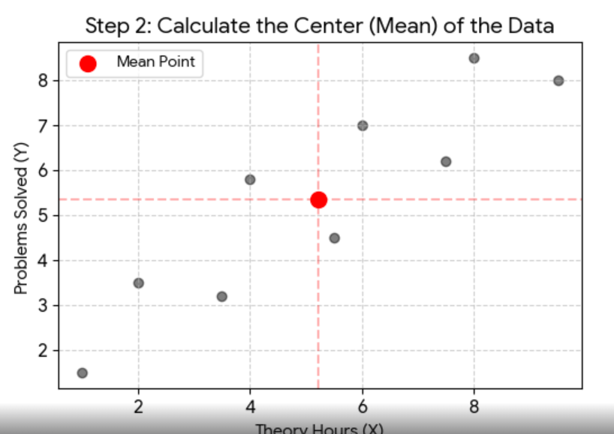
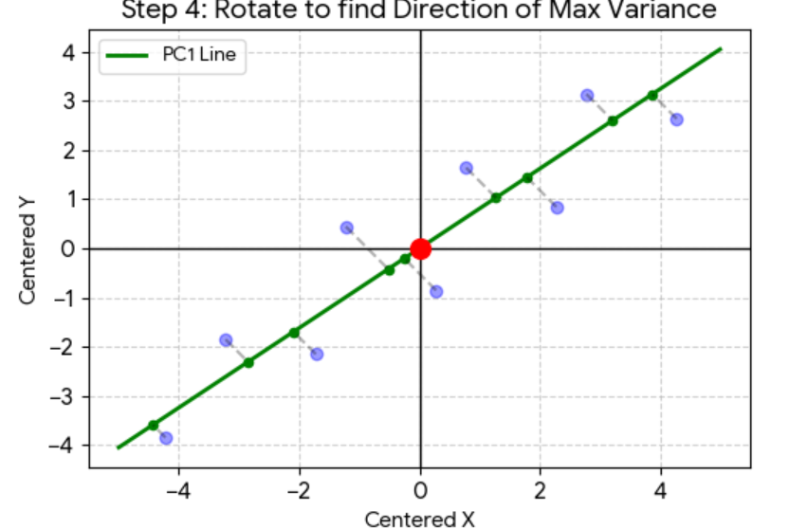
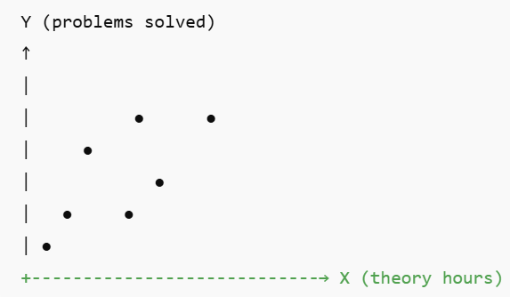
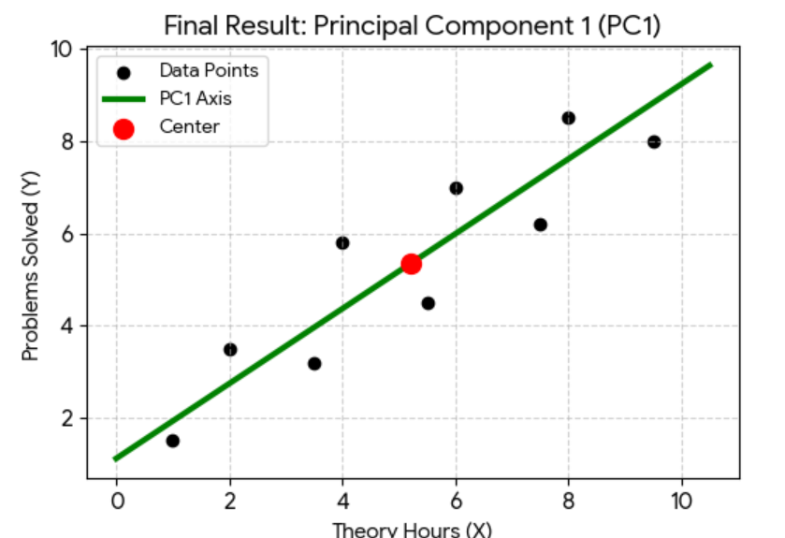
Principal Component Analysis (PCA)
Step 2: Find the Center (Mean):
Calculate Mean(X) and Mean(Y)
This point () = “Center of gravity” for our data -> All PCs must pass through it
Unsupervised
Finds directions of maximum variance
New features = Linear combinations of old ones
Example: Original features = (height, weight, waist, BMI)
PC1 = overall body size
PC2 = body shape
Step 3/4: The “Best fit” rotation
Imagine a line passing through this point
PCA “rotates” it till two equivalent conditions are satisfied
Maximum variance: When we project the line, data points should be as spread out as possible
Minimum distance: Sum of squares of distances from each point to the line should be minimum
Step 1: Plot all the points
X = Hours of theory study
Y = Practical problems solved
Some students
Study a lot, solve less
Solve a lot, study less
Are inconsistent
Summary
Points are scattered
Trend exists, but it is noisy
Not all students behave the same
PCA does not force a perfect line
It asks: In which direction does the data vary the most, overall?
PC1 (Overall academic effort) = Distance from the “average” student
Captures the most important trend – Students who study more theory hours also tend to solve more practical problems = (w1 x Theory) + (w2 x Practical)
We have “compressed” two features into one component
Student | Theory Hours (X) | Problems Solved (Y) | PC1 Value (The "Summary")
1 | 1.0 | 1.5 | -5.83
2 | 2.0 | 3.5 | -3.95
3 | 3.5 | 3.2 | -2.88
4 | 4.0 | 5.8 | -0.95
5 | 5.5 | 4.5 | -0.45
6 | 6.0 | 7.0 | 1.35
7 | 7.5 | 6.2 | 1.94
8 | 8.0 | 8.5 | 3.77
9 | 9.5 | 8.0 | 5.00

Slide 15
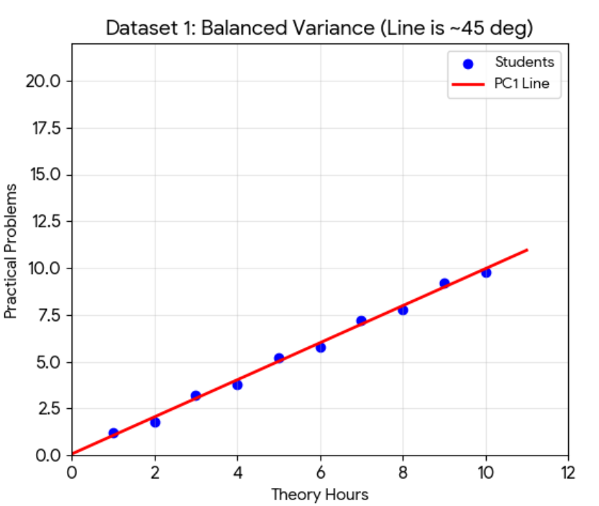
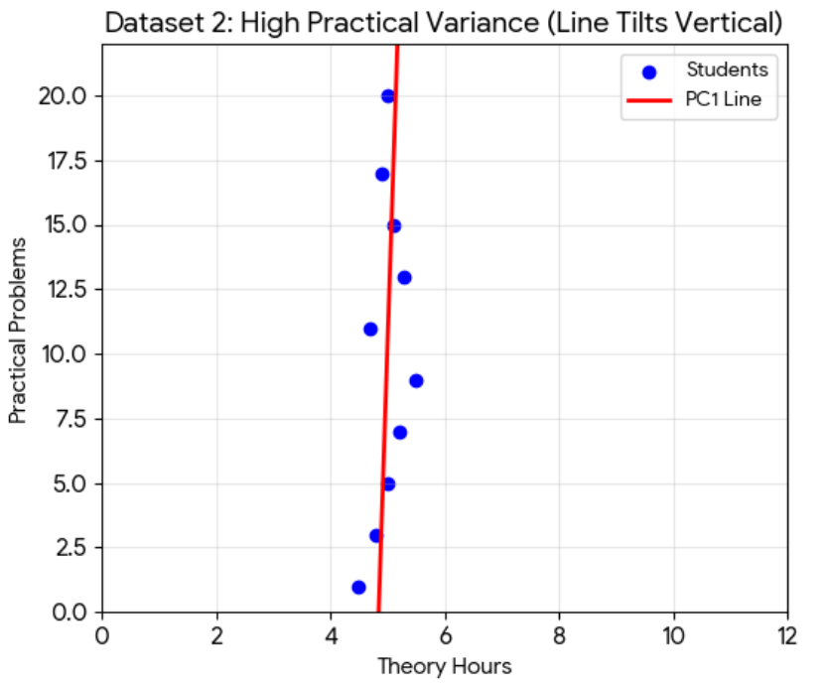
How PCA Captures the “Most Variance”
Similar variance in Theory and Practical Hours (Diagonal between X and Y axes) => w1 ≈ w2
Much more variance in Practical Hours (Tilting towards the Y-axis) => w2 will be much stronger than w1

Slide 16
t-SNE (t-Distributed Stochastic Neighbour Embedding)
A non-linear dimensionality reduction technique mainly used for visualizing high-dimensional data in 2D or 3D
Points that are close in high-D space should remain close in 2D
Converts distances into probabilities
Tries to match these probabilities in low dimensions
Reveals clusters clearly
Preserves nearest-neighbor relationships
Very popular for embeddings, images, text vectors
Excellent for seeing local clusters, but useless for measuring global relationships

Slide 17
UMAP (Uniform Manifold Approximation and Projection)
A non-linear dimensionality reduction technique for fast, scalable visualization and structure preservation
Preserves local neighborhoods
Retains some global structure
Much faster than t-SNE
Can handle large datasets
Gives a faster, more stable visualization while preserving both local and partial global structure
Small data, pretty clusters → t-SNE
Large data, stability, speed → UMAP

Slide 18
When to Use What
# | Use case | Use | Reason
1 | Reduce 100 features before regression | PCA | Removes redundancy while keeping variance
2 | Visualize word embeddings (Word2Vec, BERT) | t-SNE | Shows local similarity clearly
3 | Visualize MNIST digits | t-SNE | Excellent cluster separation
4 | Large embedding dataset (100k+ points) | UMAP | Faster and more scalable
5 | Preprocessing before clustering (k-means) | PCA | Reduces noise, keeps structure
6 | Visualize customer segments | UMAP | Preserves neighborhood + global layout
7 | Detect outliers in high-dimensional data | PCA | Extreme projections stand out
8 | One-off EDA plot for presentation | t-SNE | Produces visually clear plots
9 | Incremental visualization (new data later) | UMAP | Can transform new points
10 | Compress image features before model | PCA | Linear, fast, model-friendly

